Slide 1
G
R
3
O
U
P

Slide 2
G
R
3
O
U
P

Slide 3
Can we Predict the Performance of a Movie?
PROBLEM FORMULATION
DATA EXTRACTION & CLEANING
DATA EXPLORATION & ANALYSIS
MACHINE LEARNING
INSIGHTS & CONCLUSION

Slide 4
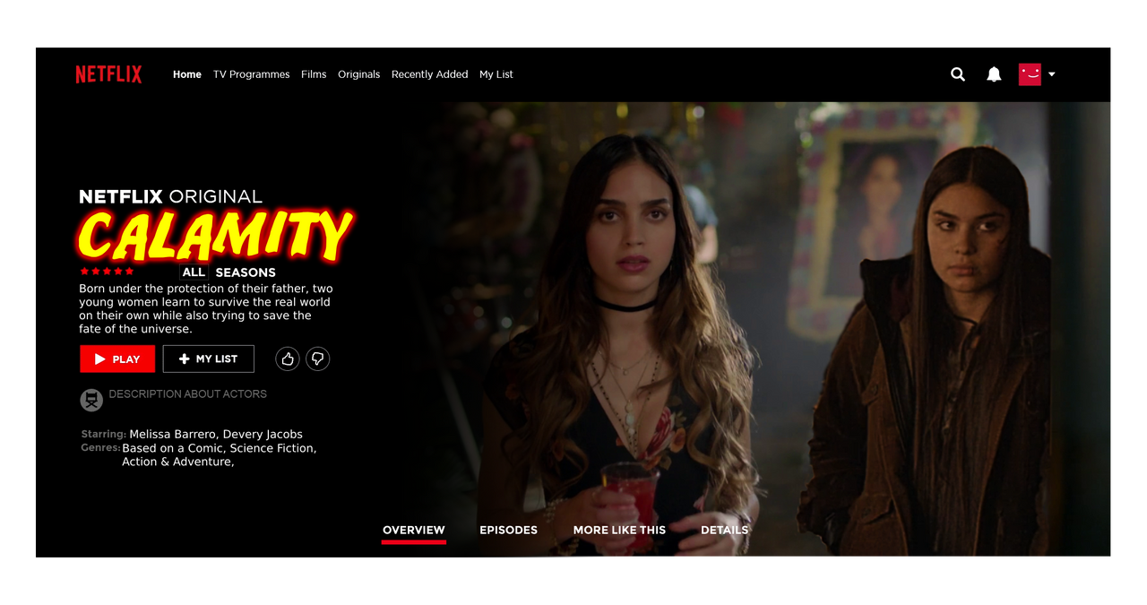

Problem Formulation
In this section, we will be describing our thought process and the reason why we decided to choose our main problem question.

Slide 5
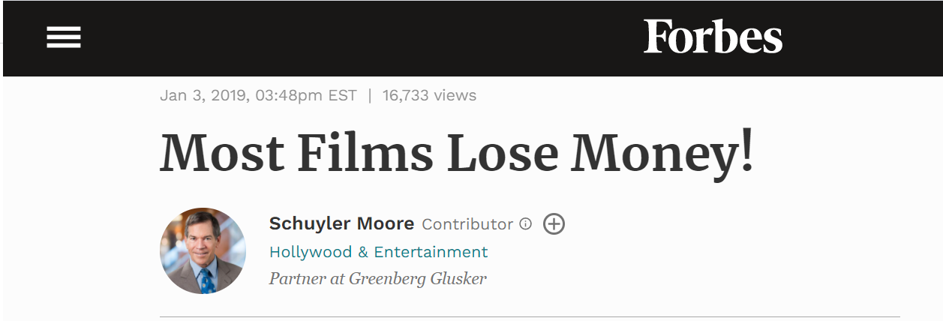
Problem Formulation

Slide 6

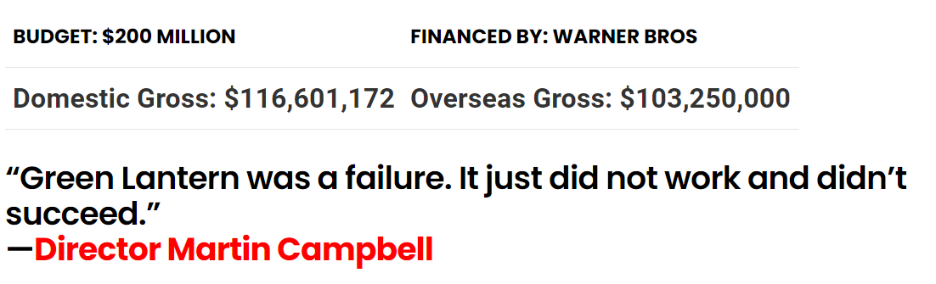
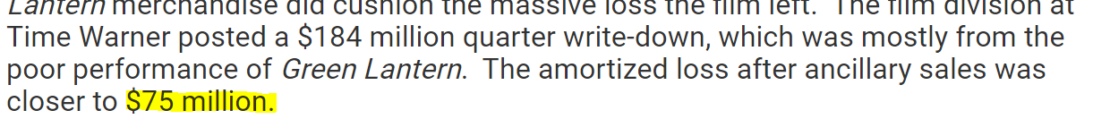
Problem Formulation

Slide 7
Problem Formulation
peRformance
profit
revenue
ratings

Slide 8
Data Extraction & cleaning
Hello my name is kass and i suck. I have a very awesome sister who helps me do my assignments. She is the best. I want to reiterate the fact that I am dumb. BYE!

Slide 9
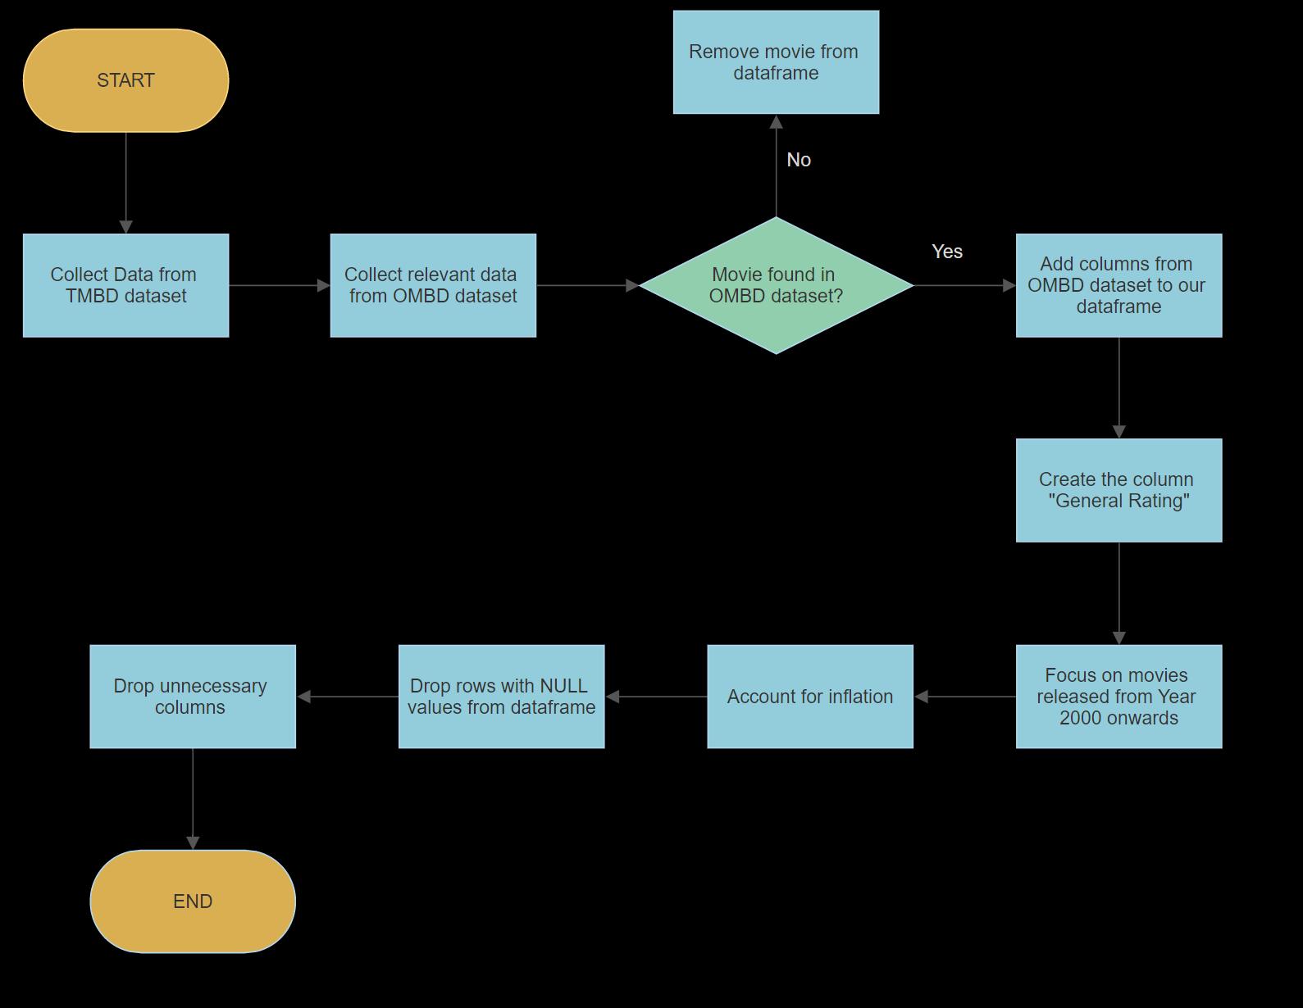
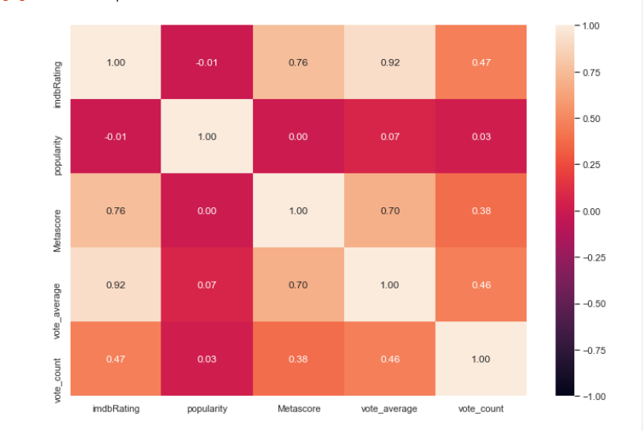
Data Extraction & Cleaning

Slide 10
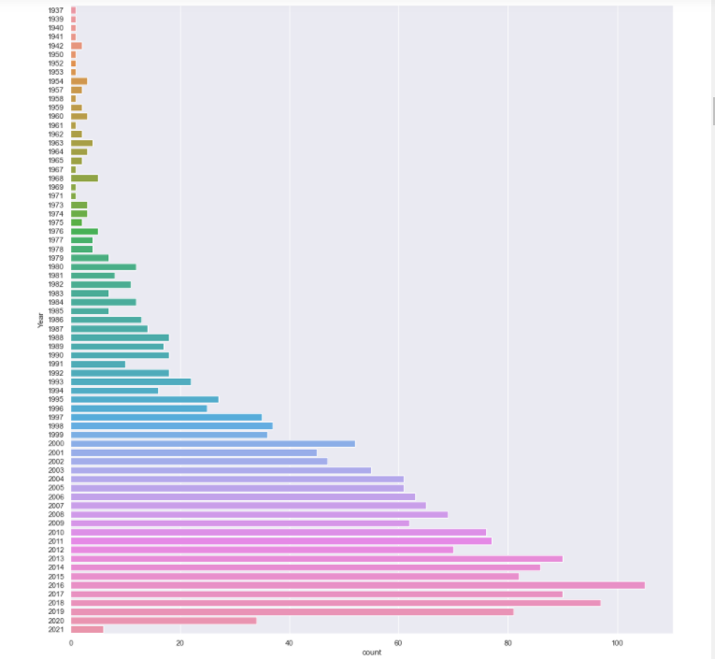

Slide 11
Find real growth
Stabilize the variance of random or seasonal fluctuations
Highlight cyclical patterns in dataset
Data Extraction & Cleaning
Adjusted profit = (old_profit*cpi_current)/cpi_old

Slide 12
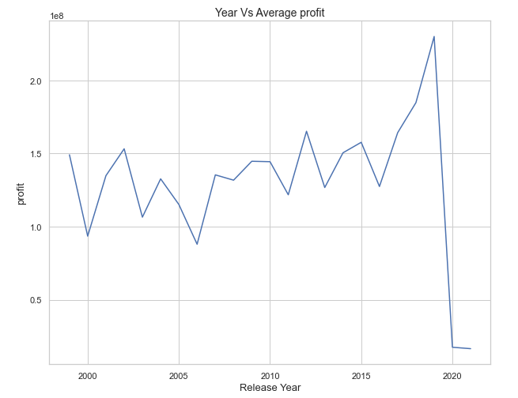
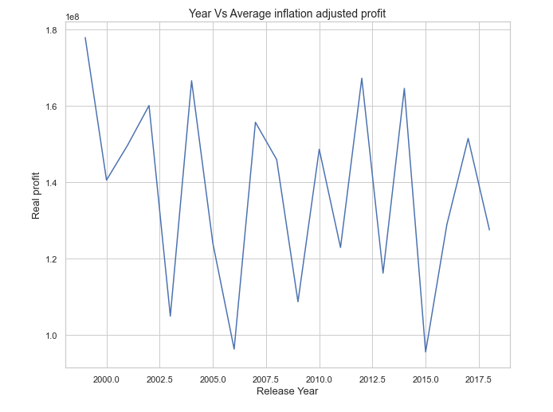
Data Extraction & Cleaning
UNADJUSTED
VS
ADJUSTED

Slide 13
Data exploration & Analysis
Hello my name is kass and i suck. I have a very awesome sister who helps me do my assignments. She is the best. I want to reiterate the fact that I am dumb. BYE!

Slide 14
Data Exploration & Analysis
Numerical
predictors
Response
Variables
Budget
Revenue
RUN TIME
Profit
Ratings

Slide 15
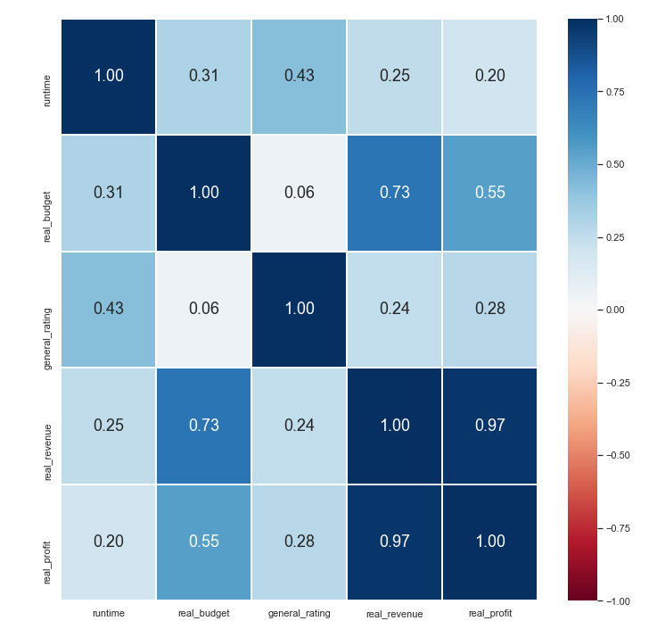
Data Exploration & Analysis

Slide 16
Data Exploration & Analysis
categorical
predictors
Release month
genre
Release year
language

Slide 17
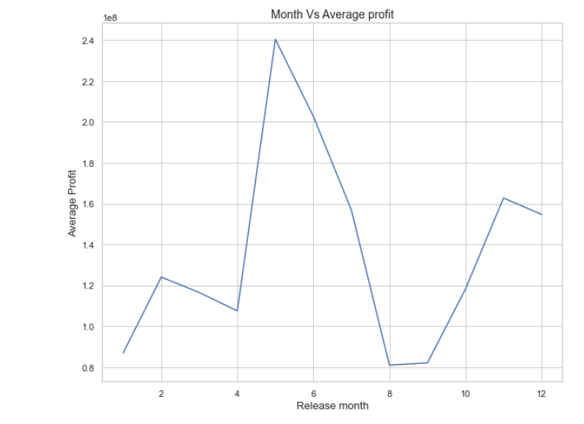
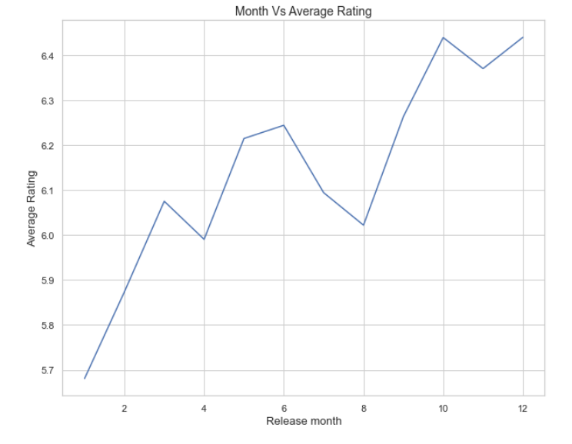
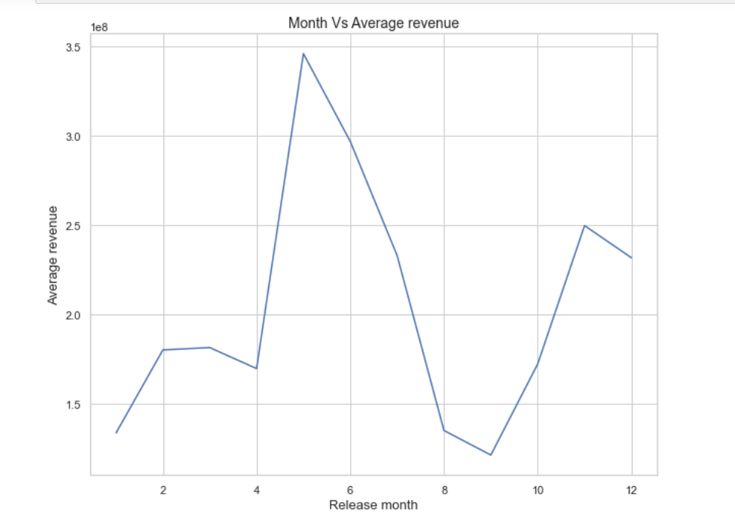
Data Exploration & Analysis

Slide 18
Machine learning
How we went about our machine learning

Slide 19
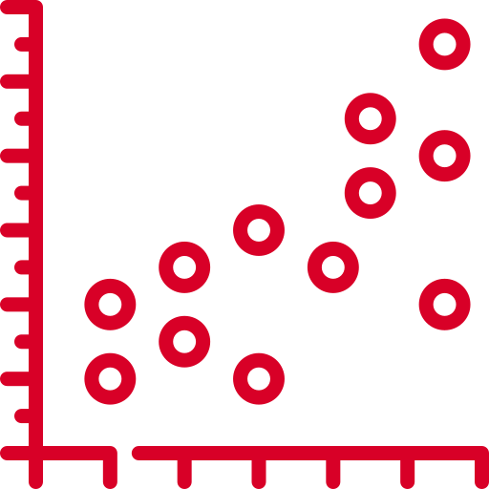
Why Regression?
Response variables are generally continuous
Able to extrapolate/interpolate
Very empty tho, i’ll see if i can find more stuff to add
Machine Learning

Slide 20

Bayesian Model
More accurate for smaller sample sizes
Difference in regression methods
more flexible and can handle more complex models
Machine Learning

Slide 21

Process
Split data into train and test dataframes
Train a univariate model
attempt to predict response variables with a single predictor
Train a multivariate model
Attempt to predict response variables with a combination of both predictors
Machine Learning

Slide 22
Insights & CONCLUSION
Hello my name is kass and i suck. I have a very awesome sister who helps me do my assignments. She is the best. I want to reiterate the fact that I am dumb. BYE!

Slide 23
Insights & Conclusion

Slide 24
Insights & Conclusion

Slide 25
THANK YOU!

